Slide 1
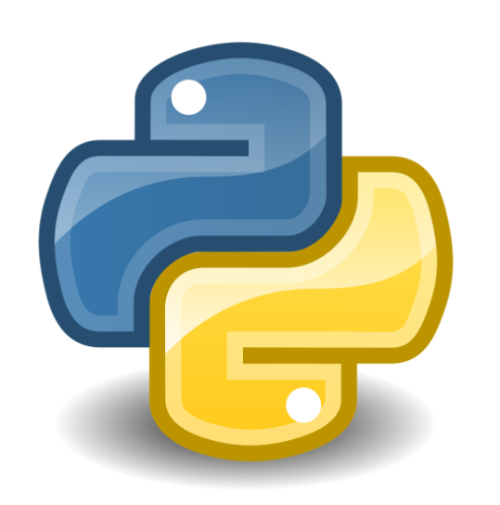
Python and Anaconda
December 4, 2017

Slide 2
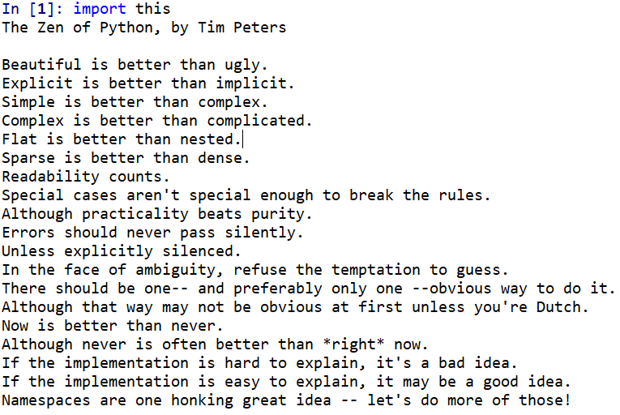
What is Python?
Python is an interpreted, object-oriented, high-level programming language with dynamic semantics. Its high-level built in data structures, combined with dynamic typing and dynamic binding, make it very attractive for Rapid Application Development, as well as for use as a scripting or glue language to connect existing components together. Python's simple, easy to learn syntax emphasizes readability and therefore reduces the cost of program maintenance. Python supports modules and packages, which encourages program modularity and code reuse. The Python interpreter and the extensive standard library are available in source or binary form without charge for all major platforms, and can be freely distributed.
Python.org

Slide 3
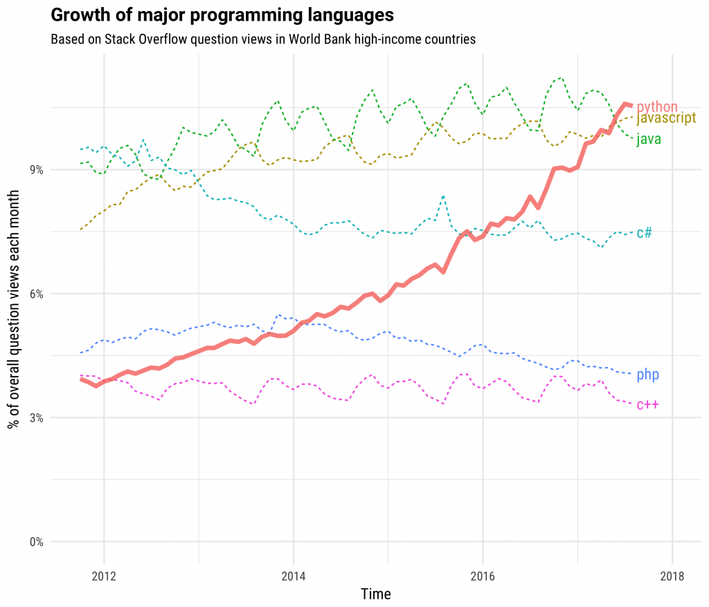
Why learn Python?
Python is becoming the most relevant programming language of today.
As a general purpose scripting language, it has a wide range of applications.
It is easy to learn. Python is currently the most popular language for teaching introductory computer science courses at top-ranked U.S. departments
Python powers well-known companies and applications such as Google, Dropbox, Pinterest, Instagram, Reddit, BitTorrent
Python has a very well-designed core of data science capabilities
Python is open-source which makes it free and also has a vibrant community of contributors.
Source: https://stackoverflow.blog/2017/09/06/incredible-growth-python/

Slide 4
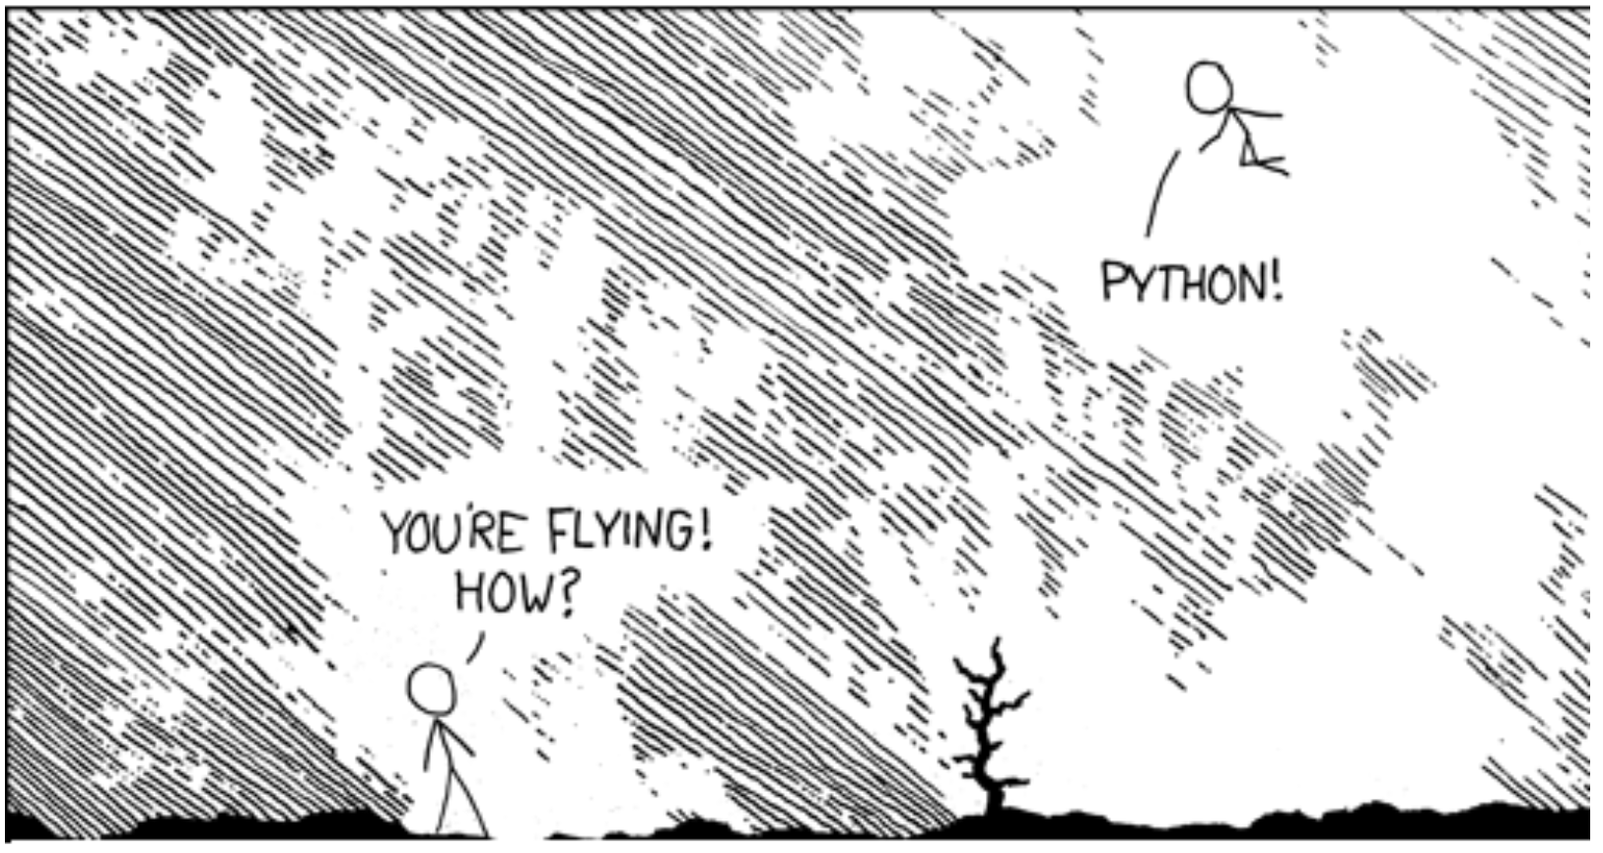
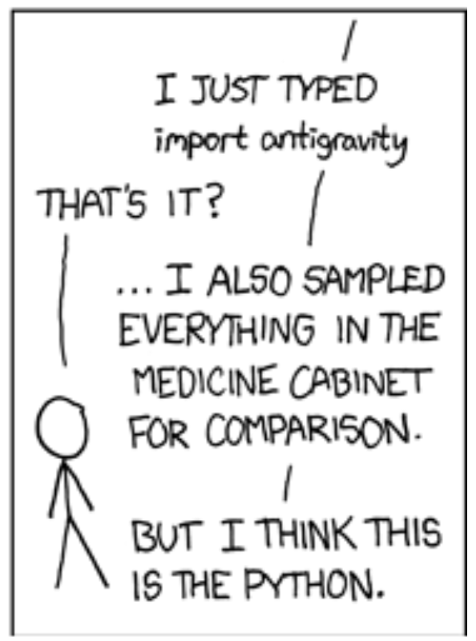
The Package System
Python has over 120,000 packages – That’s a LOT
Think of packages as capabilities that extend the functionality of Python
You have freedom to choose which packages you want installed in your Python environment (use conda or pip) and which ones to include in any particular task or analysis (use import)

Slide 5
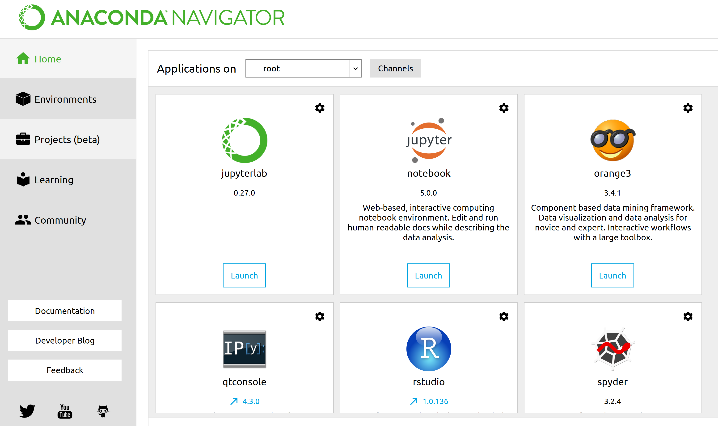
What is Anaconda?
Anaconda is a python distribution, with installation and package management tools.
It provides large selection of packages and commercial support. It is an environment manager, which provides the facility to create different python environments, each with their own settings.
It has a series of apps that facilitate data analysis and analytics and Python development
It makes the management of your Python set-up easy.
It comes pre-loaded with most of the common packages used in data science.

Slide 6

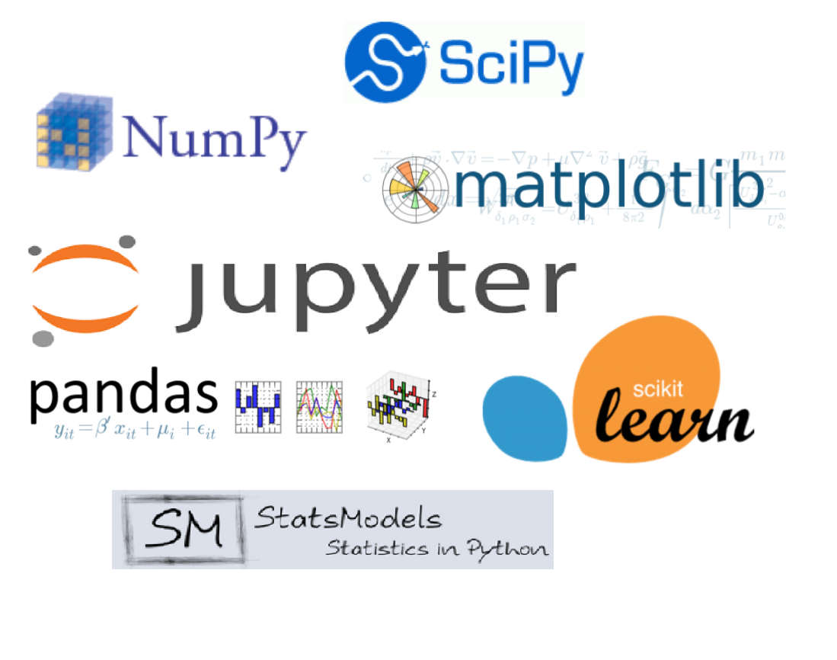
Data Science Core
Pandas - high-performance, easy-to-use data structures and data analysis tools
Numpy – Blazing fast array and linear algebra functions
Matplotlib – Defacto visualization library of Python
SciPy - collection of mathematical algorithms and convenience functions
Jupyter – Web-based Interactive computing environment
Scikit-learn – Machine-learning suite
StatsModels – classical statistics and likely candidate for our predictive pricing models

Slide 7
Additional Useful Packages
ETL
Analytics
Vizualization
pyodbc – Establish ODBC connections directly in Python
re – regular expression mini-language used for complex string manipulation – think extracting structured data from unstructured documents
beautifulsoup – HTML parser that facilitates web scraping
sqlalchemy – the Python SQL toolkit and Object Relational Mapper that gives application developers the full power and flexibility of SQL
quandl – online compendia of publicly available financial data
seaborn – abstraction of matplotlib that makes graphics in fewer lines of code
bokeh - interactive web-based visualization package designed around the ‘grammar of graphics’.
geopandas – Gepgraphic mapping capabilities
NLTK – Natural language processing toolkit extracts predictive/prescriptive insights out of free-form text
rpy2 – utiity package that exposes the entirety of the R package ecosystem to Python
Networkx – facilitates complex network analysis
keras/tensorflow – Deep learning in Python
chainladder – Bulk reserving package under active development by yours truly
But there are so many more…

Slide 8



Learn by doing
Learn Python Syntax basics. Geared towards non-programmers and is best place to start. Free tier is very extensive.
Smattering of training modules geared towards Data Science. Relatively cheap subscription service to get hands-on coding practice but also developing a data science mindset.
Applied Data Science with Python Specialization (University of Michigan). Graduate from toy examples with walk-throughs to independent programming and analytics assignments.

